Slide 1
The use and abuse of an AI
Helge Smeby
Reidar Husmo

Slide 2
Presentation topics
Real-life application of Machine Learning to improve productivity and efficiency
Analysis and review of content discovery mechanisms and intelligent collaboration
Interfacing Office 365 from a machine learning point of view

Slide 3

Who are we?
REIDAR HUSMO
@reidarhusmo
Reidar.husmo@gmail.com
HELGE SMEBY
@helgesmeby
helge.smeby@outlook.com

Slide 4

Your workplace on the internet
E-mail
Calendar
Social media (Yammer)
Personal file storage (OneDrive for business)
Team collaboration sites
Content tools
Word
Excel
Powerpoint
OneNote

Slide 5
Used by > 1.2 BN people
Popular in schools
Multi-platform / multi-device

Slide 6
Finding information

Slide 7
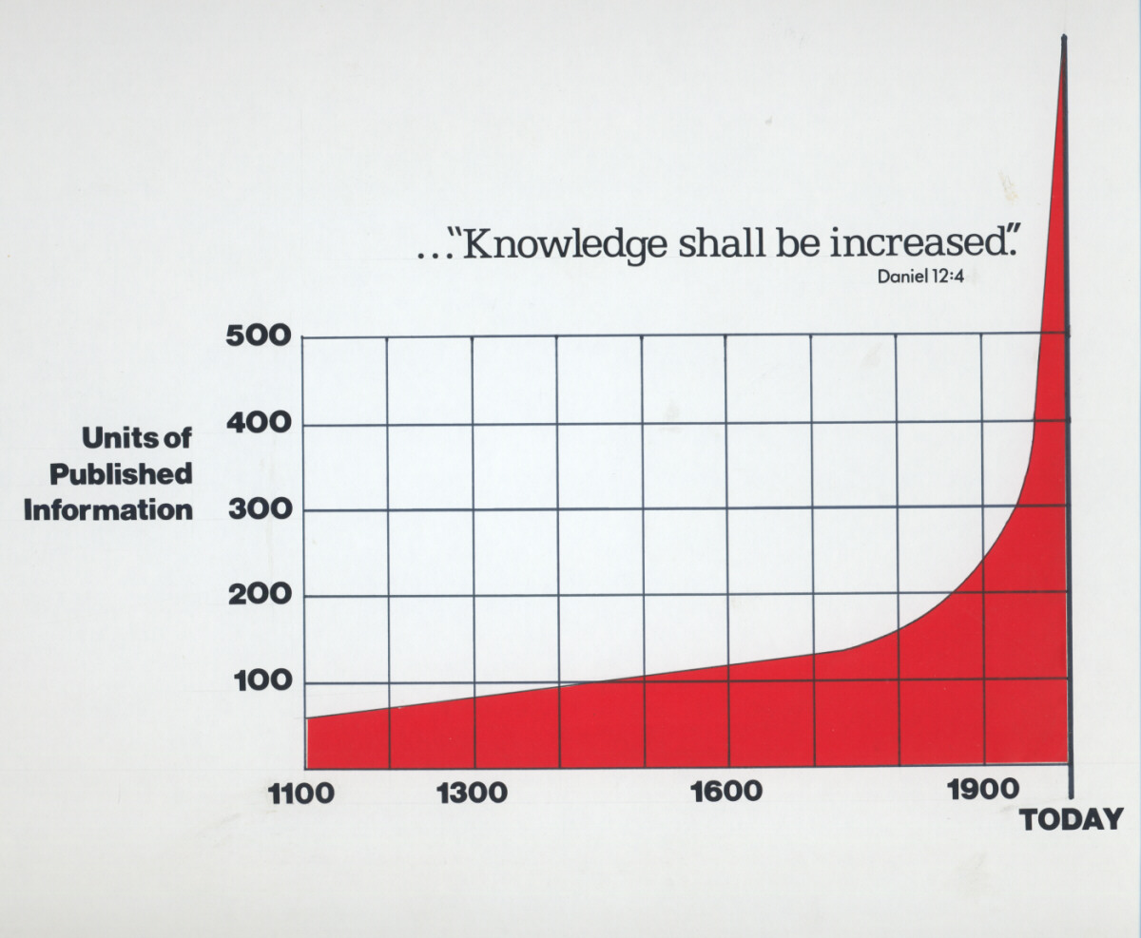

Slide 8
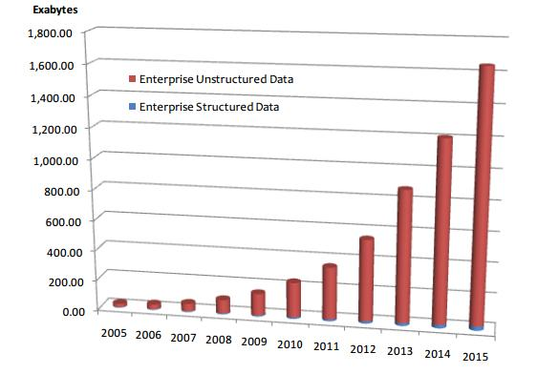

Slide 9
Finding information
 | Search | Discovery
Open | 1980: Library (Dewey!) 1990: AltaVista 2000: Google, AllTheWeb, Bing, Ms Dewey 2010: Google, Bing, DDG | 1980: News, magazines, Dewey 1990: portal, news, magazines 2000: www, Facebook 2010: www, Facebook
Closed | 1980: Archive, AAE 1990: Fileshare 2000: SharePoint 2010: SharePoint | 1980: Smoking area, watercooler, lunch 1990: Watercooler, lunch 2000: Lunch, Yammer 2010: Delve, (W by F), Slack

Slide 10
A new generation of workers
Expect content to be delivered, not found
Rapid content consumption and filtering
No relation or interest in search operators
No patience
Expectation of intelligence / smartness

Slide 11
A new generation of content
Content is no longer just documents
Images
Video
Social media
Messages (E-mail / IM / SMS)
No time or patience for metadata-tagging ☹

Slide 12
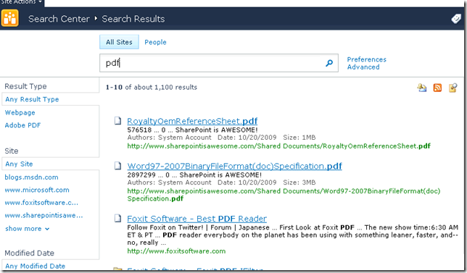
Traditional search

Slide 13



Slide 14
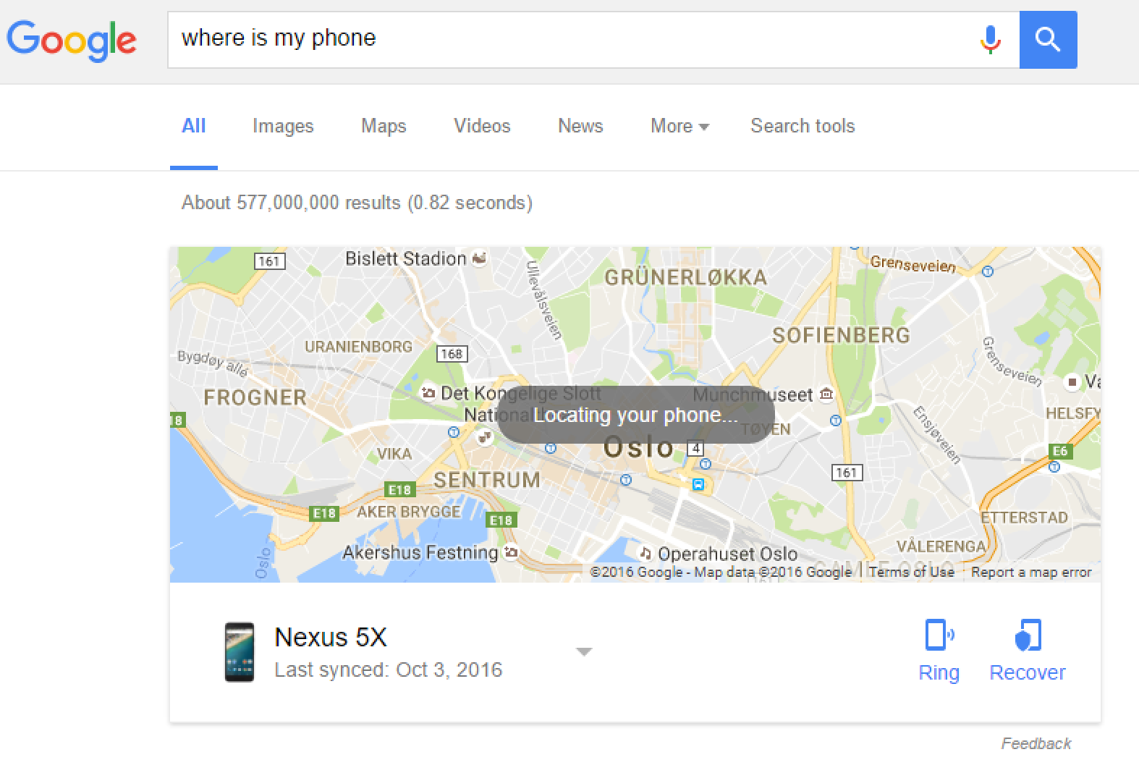
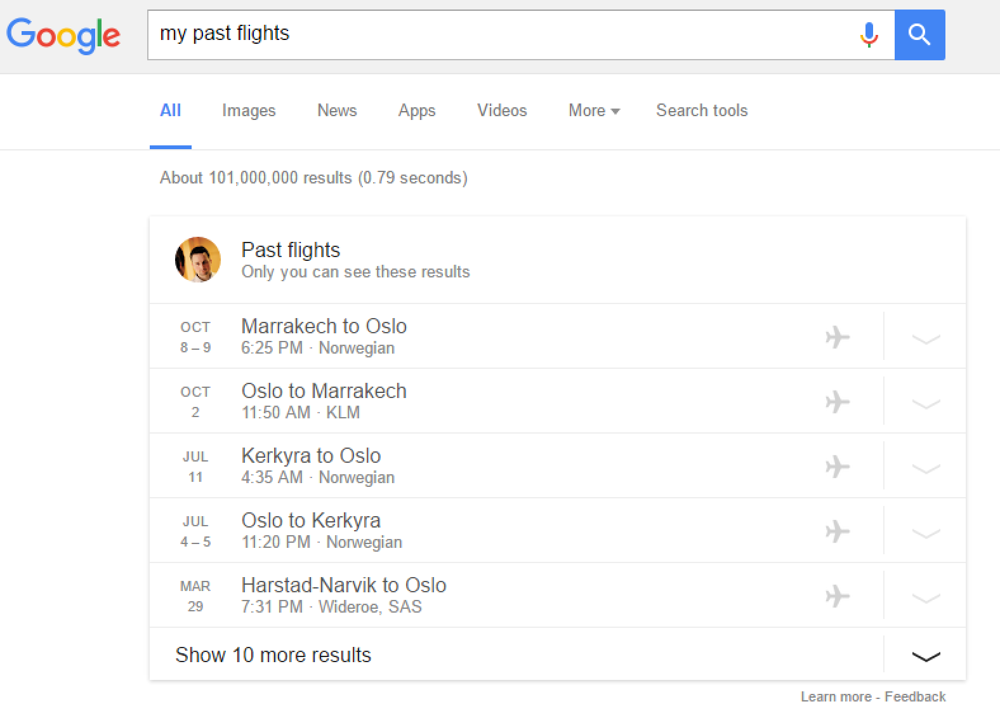
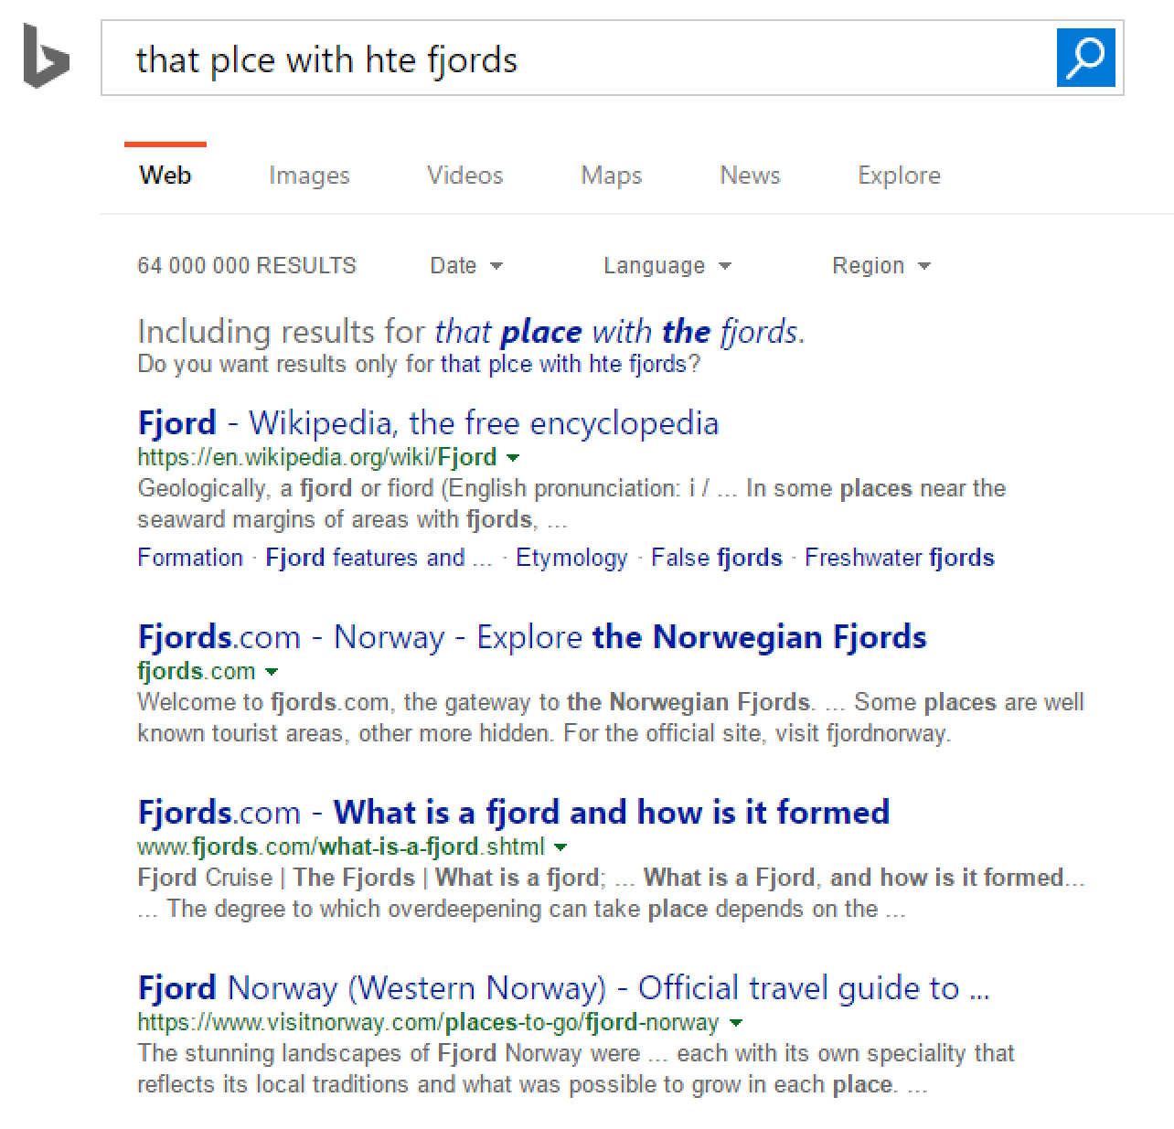
Modern search

Slide 15




Every breath you take

Slide 16
The solution

Slide 17
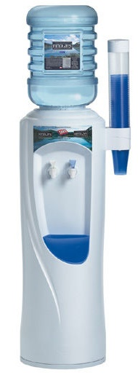
Content discovery vs. Search
Return of the watercooler
People-centric vs. Object-centric
Solutions
Know the user (Actor)
Know the data (Object)
Know the actions (Edge)
Connect the dots…
Intelligent content discovery, powered by machine learning

Slide 18

Content discovery
Problem
Users don’t want, like or understand traditional search
Solution
Machine learning
Eliminate the problem, know what users are looking for
Delve
“Next generation personalized search and discovery”
Developed in Torggata, Oslo, Norway

Slide 19
Office graph
Uses machine learning to «know» the user
«Search on steroids»
Big data
Made in norway

Slide 20
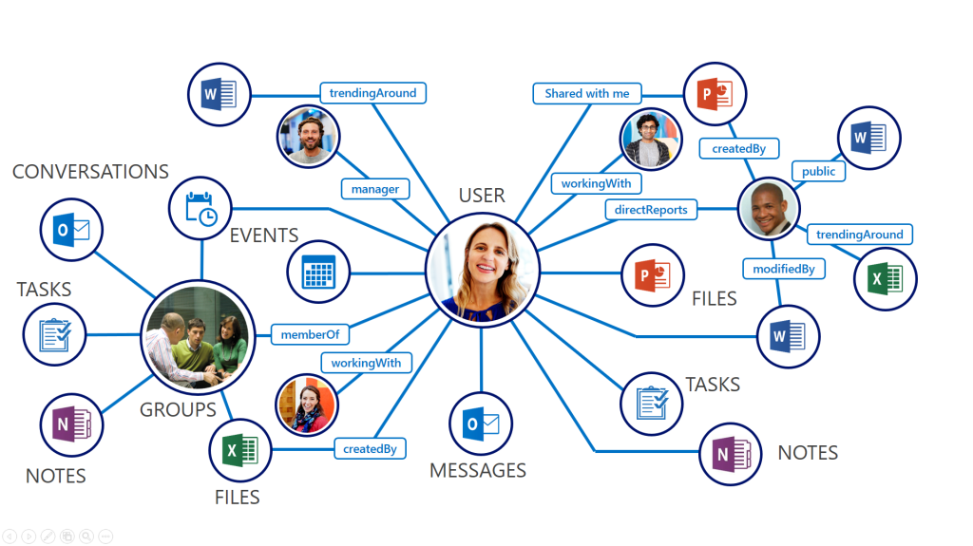
Microsoft Graph

Slide 21
“All those moments will be lost in time, like tears in rain” – Rutger Hauer

Slide 22
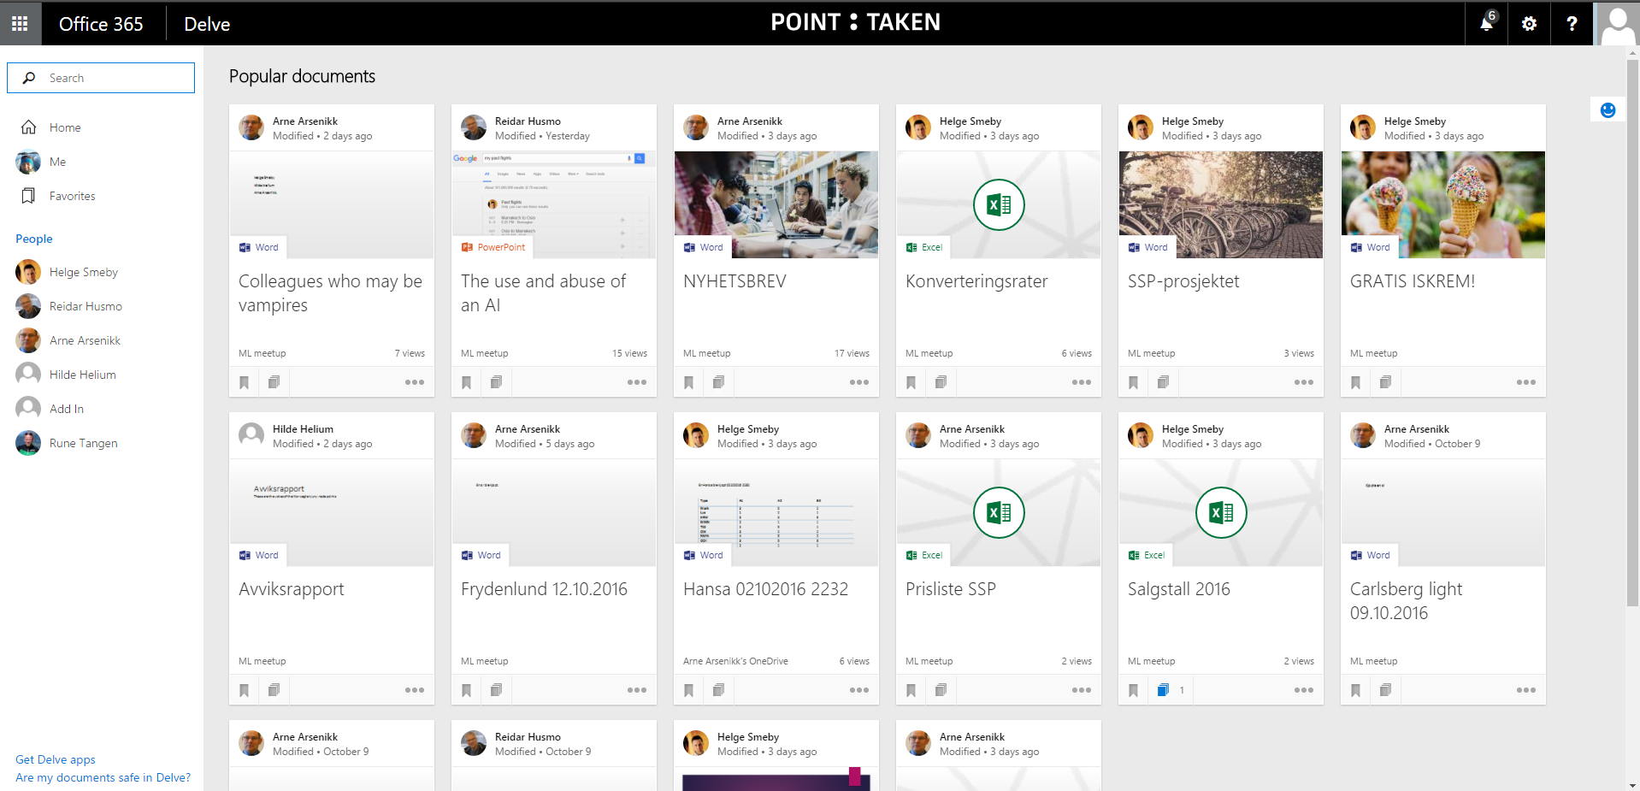

Slide 23
Delve =
Search
+ Social
+ Enterprise intelligence
+ Big data

Slide 24
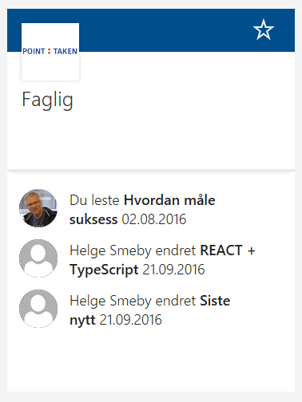

Edge - Actor - Object
Reidar leste “How to kill friends and implicate people”
Helge endret “REACT + TypeScript”

Slide 25
Challenges
Echo chamber
DUPLICATE NAMING (documents / actors)
Active vs inactive users
DigitaL vs. Analogue users
SEARCH INDEXING FREQUENCY
etc

Slide 26
Querying the graph
Delve into Delve
URL
REST

Slide 27
Computers Are Useless. They Can Only Give You Answers – Pablo Picasso

Slide 28
_api/search/query
Graph query language
Actor Action Object
?Querytext='*'&Properties='GraphQuery:ACTOR(ME)'
?Querytext='*'&Properties='GraphQuery:ACTOR(ME\, action\:1013)'
?Querytext='*'&Properties='GraphQuery:OR(ACTOR(ME)\,ACTOR(123))'
https://graph.microsoft.io/en-us/graph-explorer

Slide 29
Edges
Action type
ID
PersonalFeed
Viewed
Modified
OrgColleague
WorkingWith
TrendingAround
WorkingWithPublic
1021
1001
1003
1015
1019
1020
1033

Slide 30
“A ship in harbour is safe. But that’s not what ships are built for.”

Slide 31
Hacking Delve
Can we fool the graph?

Slide 32
Summary
The challenge of modern content discovery
The solution to modern content discovery (Delve)
How to interface and consume (and abuse) the graph
Delve is only the first «view» of Office Graph

Slide 33
A wise man can learn more from a foolish question than a fool can learn from a wise answer. - Bruce Lee

Slide 34
For further reference
https://msdn.microsoft.com/en-us/office/office365/howto/query-office-graph-using-gql-with-search-rest-api
http://www.sharepointtalk.net/2014/11/delve-and-office-graph-for-it-pros.html

